Slide 1

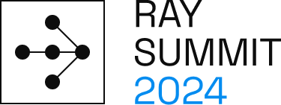

The State of vLLM 2024
Zhuohan Li & Kuntai Du,
Ray Summit vLLM Track

Slide 2
vLLM's Goal
Build the fastest and
easiest-to-use open-source
LLM inference & serving engine

Slide 3
vLLM Early Timeline
August 2022 | OPT 175B Serving Demo
December 2022 | ChatGPT out
February 2023 | vLLM PagedAttention paper
March 2023 | Vicuna and Chatbot Arena
April 2023 | vLLM PagedAttention paper submitted
June 2023 | Open-source vLLM
Pain Points Solved:
Serving LLM is expensive, vLLM delivers best cost.

Slide 4



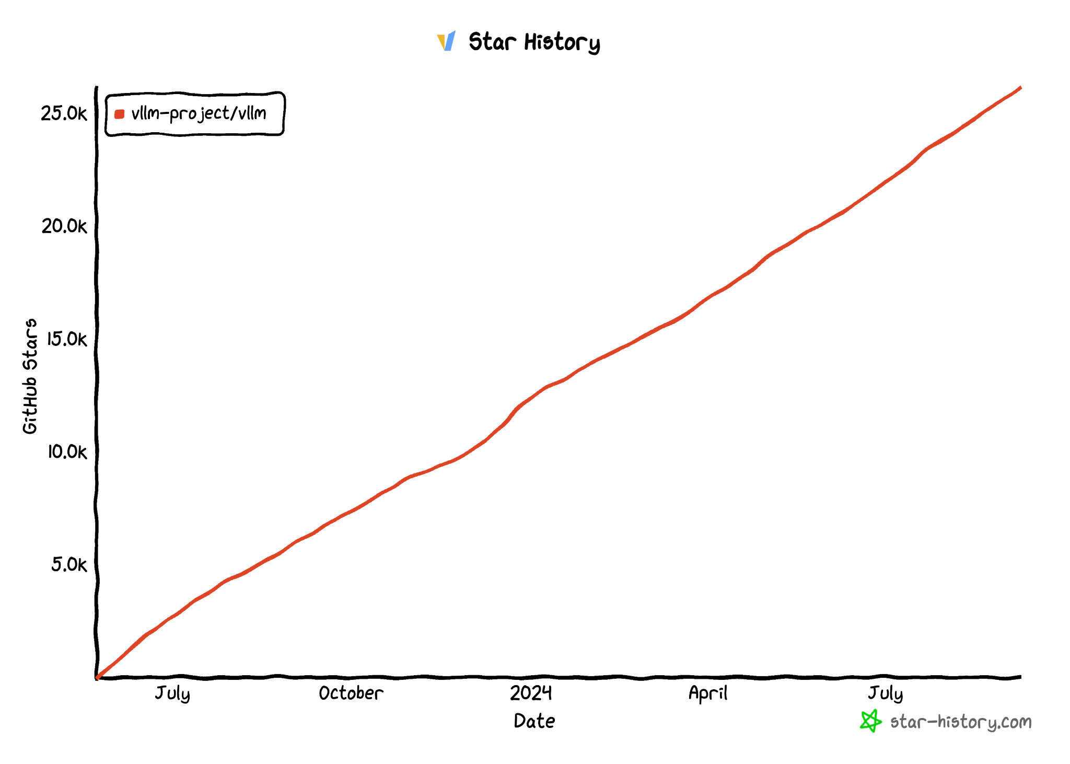
vLLM Today
https://github.com/vllm-project/vllm
$ pip install vllm
27.6K Stars
Official
release!

Slide 5
vLLM API (1): LLM class
A Python interface for offline batched inference
from vllm import LLM
# Example prompts.
prompts = ["Hello, my name is", "The capital of France is"]
# Create an LLM with HF model name.
llm = LLM(model="meta-llama/Meta-Llama-3.1-8B")
# Generate texts from the prompts.
outputs = llm.generate(prompts) # also llm.chat(messages)]

Slide 6
vLLM API (2): OpenAI-compatible server
A FastAPI-based server for online serving
Server
$ vllm serve meta-llama/Meta-Llama-3.1-8B
Client
$ curl http://localhost:8000/v1/completions \
-H "Content-Type: application/json" \
-d '{
"model": "meta-llama/Meta-Llama-3.1-8B",
"prompt": "San Francisco is a",
"max_tokens": 7,
"temperature": 0
}'

Slide 7
vLLM: One-Year Journey
Model Support
Hardware Support
Model Performance
Engine Features
Distributed System Architecture
OSS Community

Slide 8
vLLM: One-Year Journey
Model Support
Hardware Support
Model Performance
Engine Features
Distributed System Architecture
OSS Community

Slide 9
Broad Model Support
Transformer-like LLMs (e.g., Llama)
Mixture-of-Expert LLMs (e.g., Mixtral)
Multi-modal LLMs (e.g., LLaVA)
State-Space Models (e.g., Jamba)
Embedding Models (e.g. E5-Mistral)
Reward Models (e.g. Qwen2.5-Math-RM)

Slide 10
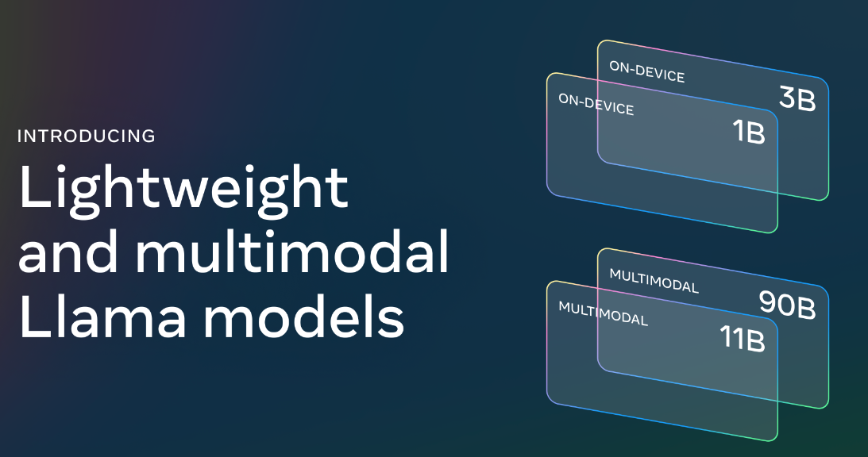


Broad Model Support
vLLM supports almost all popular open LLMs & VLMs!
Llama 3.1 & 3.2 support on day 1
Contributed by model creators
Pixtral 12B
Qwen2-VL

Slide 11
vLLM: One-Year Journey
Model Support
Hardware Support
Model Performance
Engine Features
Distributed System Architecture
OSS Community

Slide 12
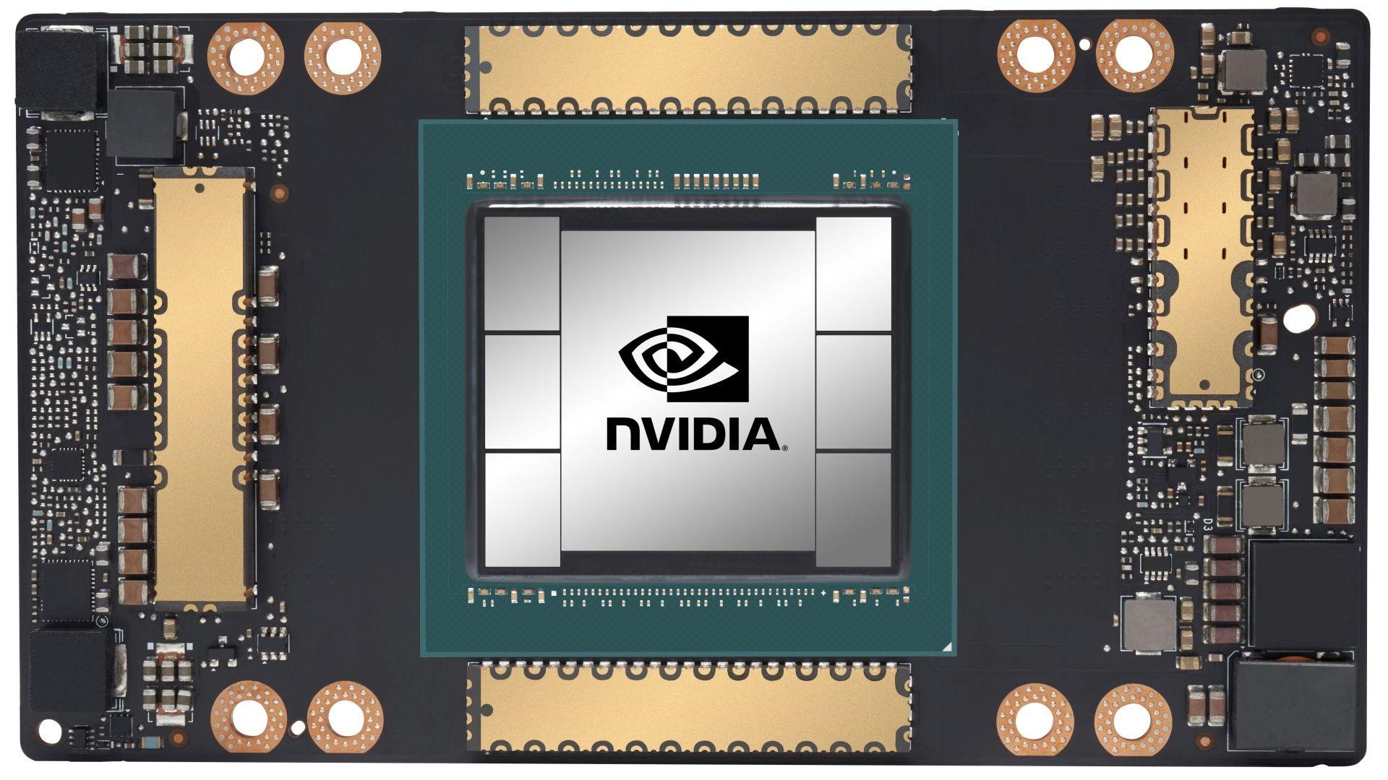

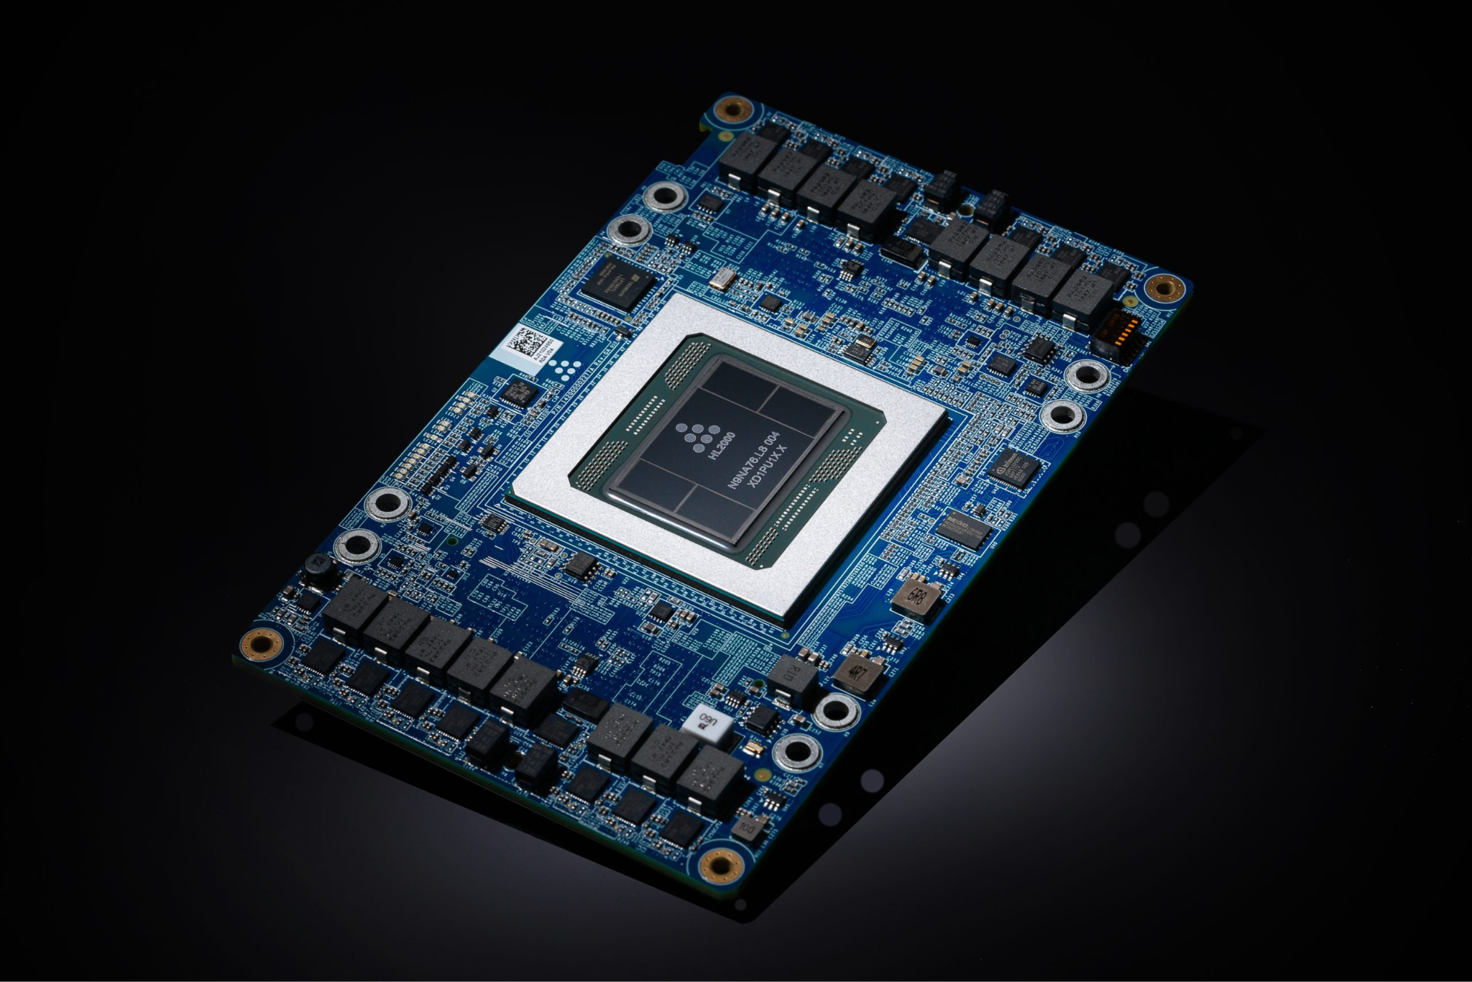
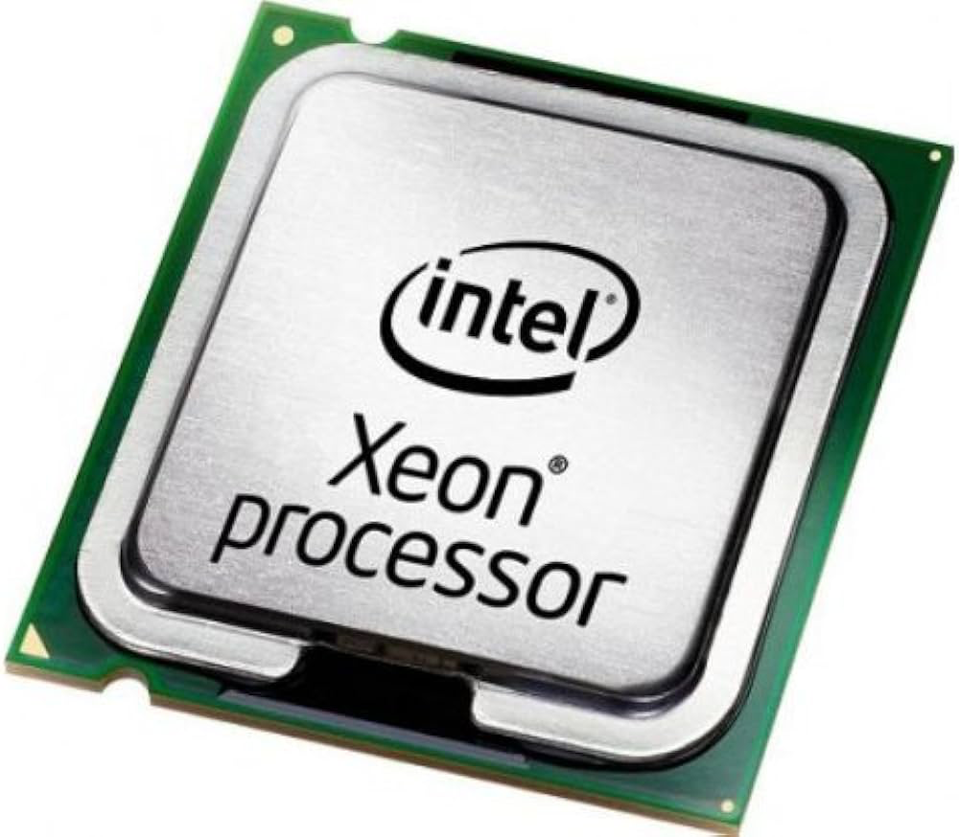
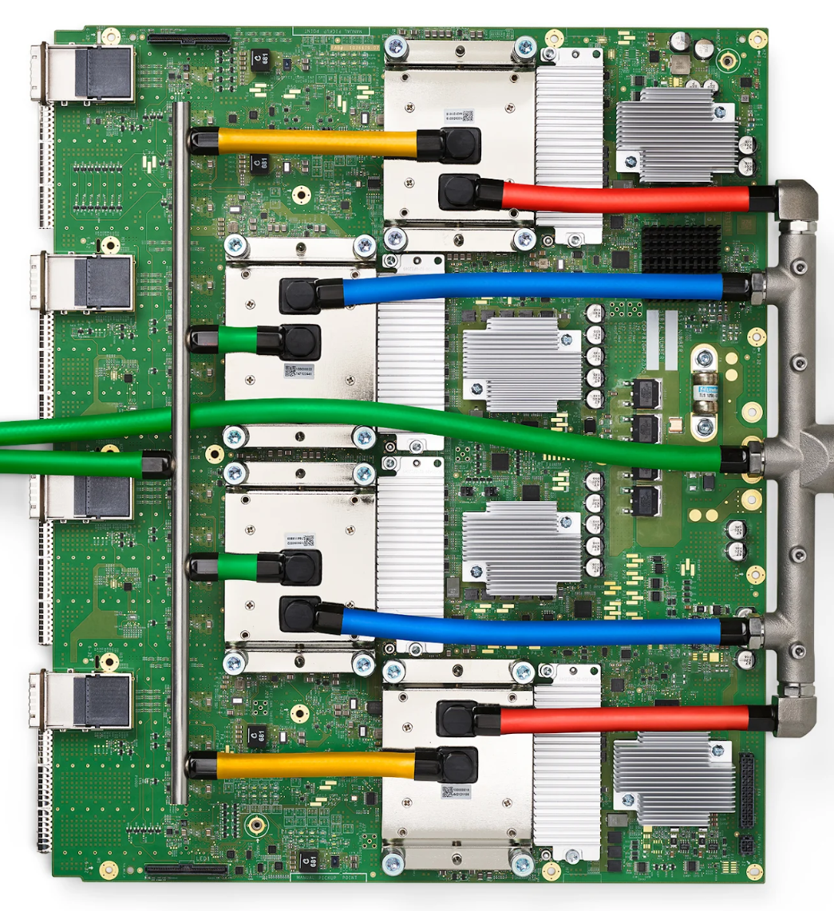
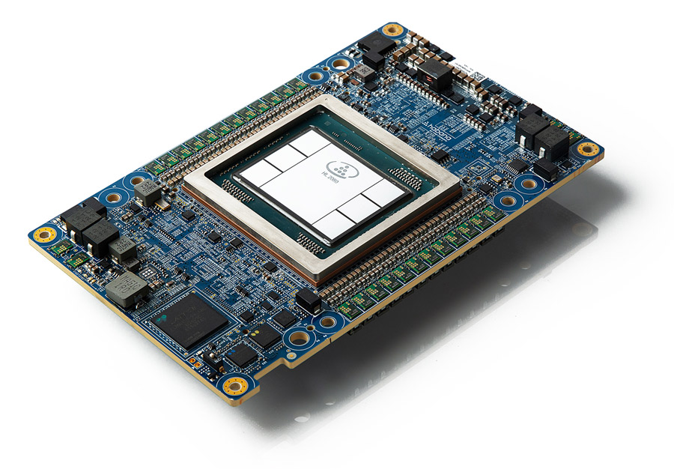
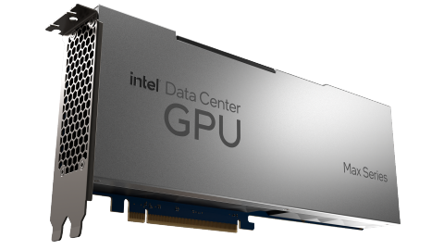
Diverse Hardware Support
Thanks to NVIDIA, AMD, AWS, Intel, and Google for contributing!
NVIDIA GPU
AMD GPU
AWS Neuron
x86 CPU
Intel GPU
Google TPU
Intel Gaudi

Slide 13

Diverse Hardware Support
Models
Utilities
PyTorch as a Narrow Waist
PyTorch
NVIDIA GPU
AMD GPU
Intel GPU
Google TPU
. . .

Slide 14
vLLM: One-Year Journey
Model Support
Hardware Support
Model Performance
Engine Features
Distributed System Architecture
OSS Community

Slide 15
Deeply optimized all the way down to cuda kernel
Quantized GeMM → Cutlass kernels
Grouped GeMM (e.g. MoE) → Triton kernels
Communication (All reduce) → CUDA kernels
(Paged) Attention → Cutlass kernels
(FlashAttention, xFormers)
Others (e.g. RoPE) → CUDA or torch.compile

Slide 16

CUDA Graph
Python/PyTorch overhead
CPU
torch.nn.Linear
torch.nn.GELU
torch.nn.Linear
GPU
matmul
kernel
gelu
kernel
matmul
kernel
Idle
Idle
Time
Python/PyTorch overhead takes up to 50% of overall latency
CPU
GPU
matmul
kernel
gelu
kernel
matmul
kernel
Time

Slide 17
Quantization Support Plan (2023)
Step 1: Develop a general abstraction for diverse quantization methods.
Step 2: Implement diverse quantization methods.
Step 3: Optimize the performance of quantized ops.

Slide 18
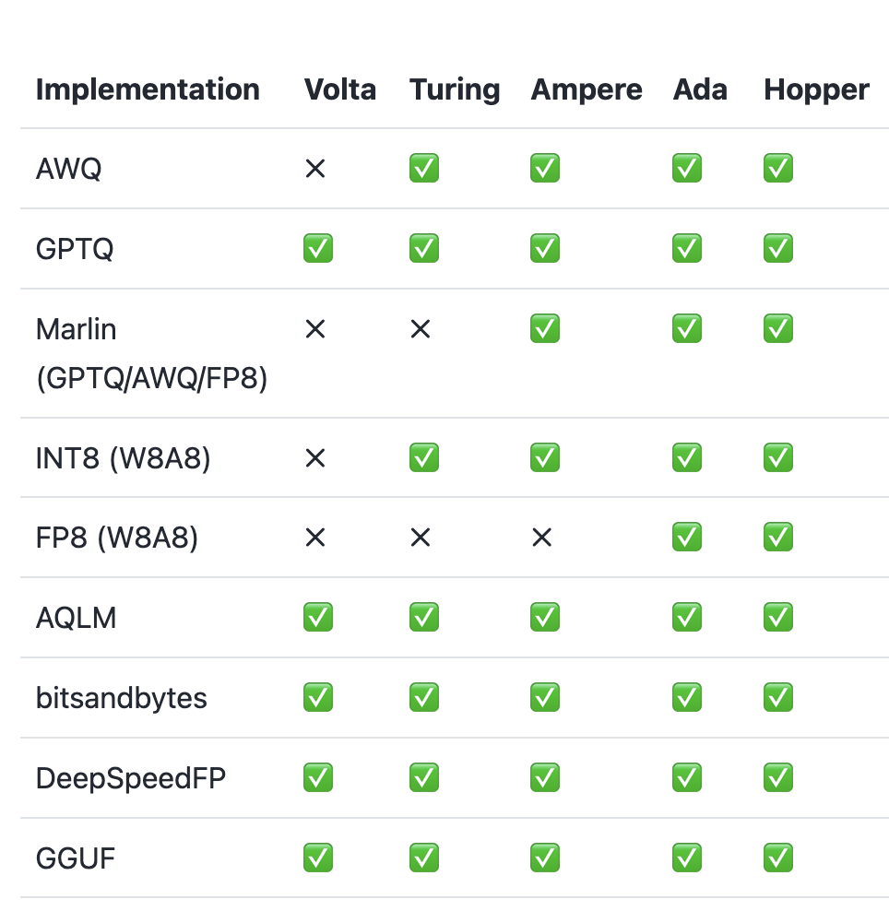
Quantization Support (2024)
Big shout-out to
Neural Magic!
vLLM supports most popular quantization methods: FP8, INT8, GPTQ, AWQ, bitsandbytes, …
Efficient quantized kernels (e.g., Marlin)
LLM Compressor toolkit to quantize the model

Slide 19
vLLM: One-Year Journey
Model Support
Hardware Support
Model Performance
Engine Features
Distributed System Architecture
OSS Community

Slide 20
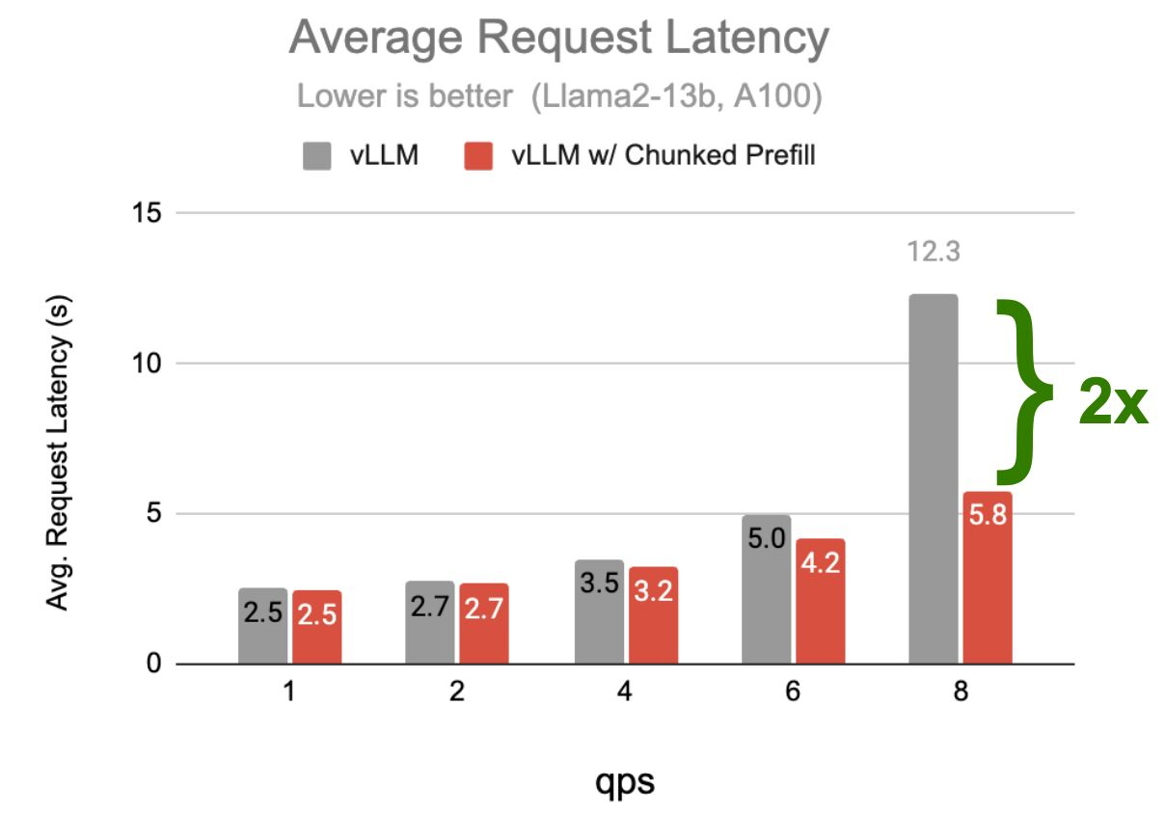
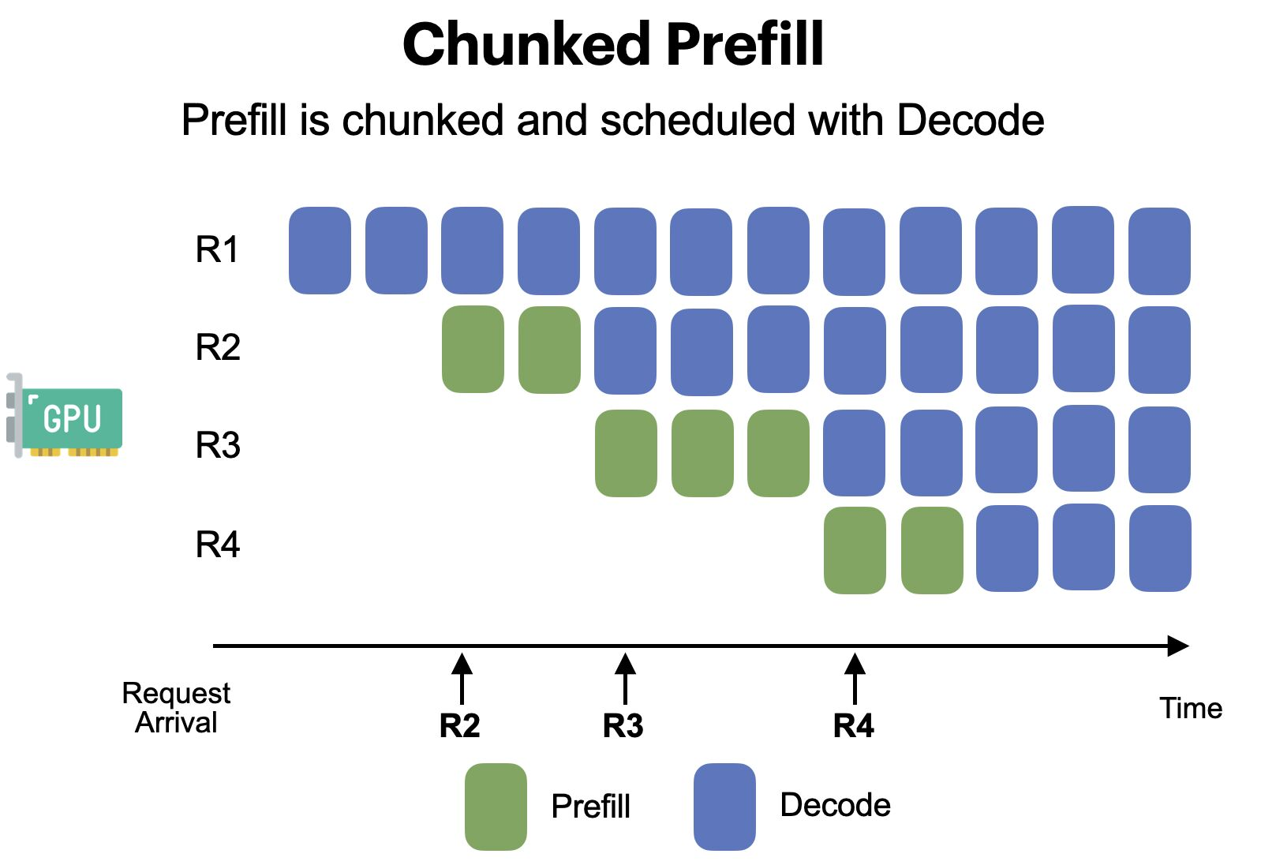
Chunked Prefill
Thanks Amey (author of chunked prefill) and Sang (Anyscale) for implementing this!
Taming Throughput-Latency Tradeoff in LLM Inference with Sarathi-Serve

Slide 21
Speculative Decoding
Large community effort led by Cade (Anyscale) and Lily (Berkeley)
Small model writes a draft → Large model verifies it
Much faster: verifying 5 tokens takes similar time as generating 1 token
Verification
Draft
Several
famous
songs
are
⑤ composed
① Several
② famous
③ songs
④ are
Large Model
(#parameter: 10xN)
Small Model
(#parameter: N)
<s>
Several
famous
songs
<s>
Several
famous
songs
are
Autoregressive (sequential)
Non-autoregressive (parallel)
* Figure adapted from Kim et al., “Speculative Decoding with Big Little Decoder” (NeurIPS 2023)

Slide 22

Dynamic Speculative Decoding
Motivation: Speculative Decoding (SD) is not always beneficial, it can slow down queries!
Solution: Dynamically adjust the propose length based on system load and speculation accuracy so that SD always improves query performance.
Checkout Optimizing Speculative Decoding for Serving Large Language Models Using Goodput for detail
Paper
High acceptance rate
Propose len
Low acceptance rate
System load

Slide 23
Hash-Based Automatic Prefix Caching
Example 1: Shared system prompt
A chat between a curious user and an artificial intelligence assistant. The assistant gives helpful, detailed, and polite answers to the user's questions. User: Hello!
Request A
A chat between a curious user and an artificial intelligence assistant. The assistant gives helpful, detailed, and polite answers to the user's questions. User: How are you?
Shared
Request B

Slide 24
Hash-Based Automatic Prefix Caching
Example 2: Multi-round conversation
Prompt (round 1)
Human: What's AI?
LLM Result (round 1)
LLM: AI is technology that simulates human intelligence, like Siri or Google Maps.
Prompt (round 2)
Human: What's AI?
LLM: AI is technology that simulates human intelligence, like Siri or Google Maps.
Human: Cool, thanks!
LLM Result (round 2)
LLM: No problem!
Shared

Slide 25
Hash-Based Automatic Prefix Caching
Request:
A chat between a curious user …
A chat between a cute puppy …
Hash(“A chat”)
reuse
Block A
[A chat]
Hash(“A chat”)
Block A
[A chat]
Request KV Blocks:
Hash(“A chat between a”)
Block B
[between a]
Hash(“A chat between a”)
reuse
Block B
[between a]
Hash(“A chat between a curious user”)
Block C
[curious user]
Hash(“A chat between a cute puppy”)
Block D
[cute puppy]
…
…

Slide 26
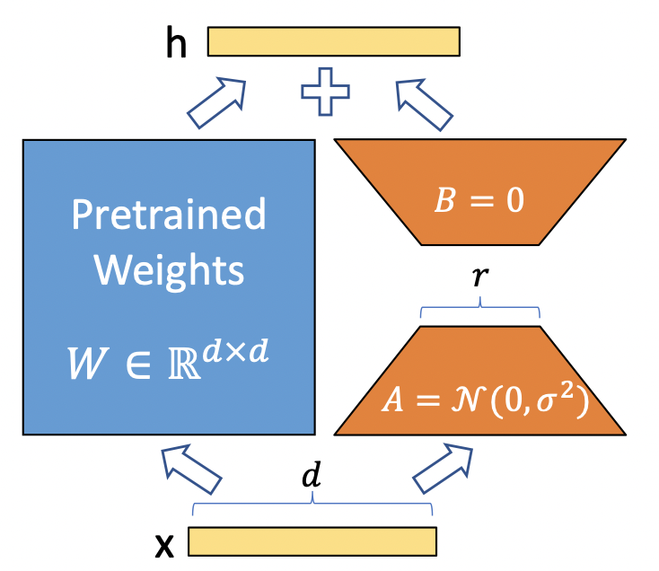
Multi-LoRA Serving
Thanks to the S-LoRA authors, Punica authors, and Anyscale for contributions!
Multiple LoRA adaptors can be loaded to vLLM on the fly, and requests to different LoRAs can be batched together.

Slide 27
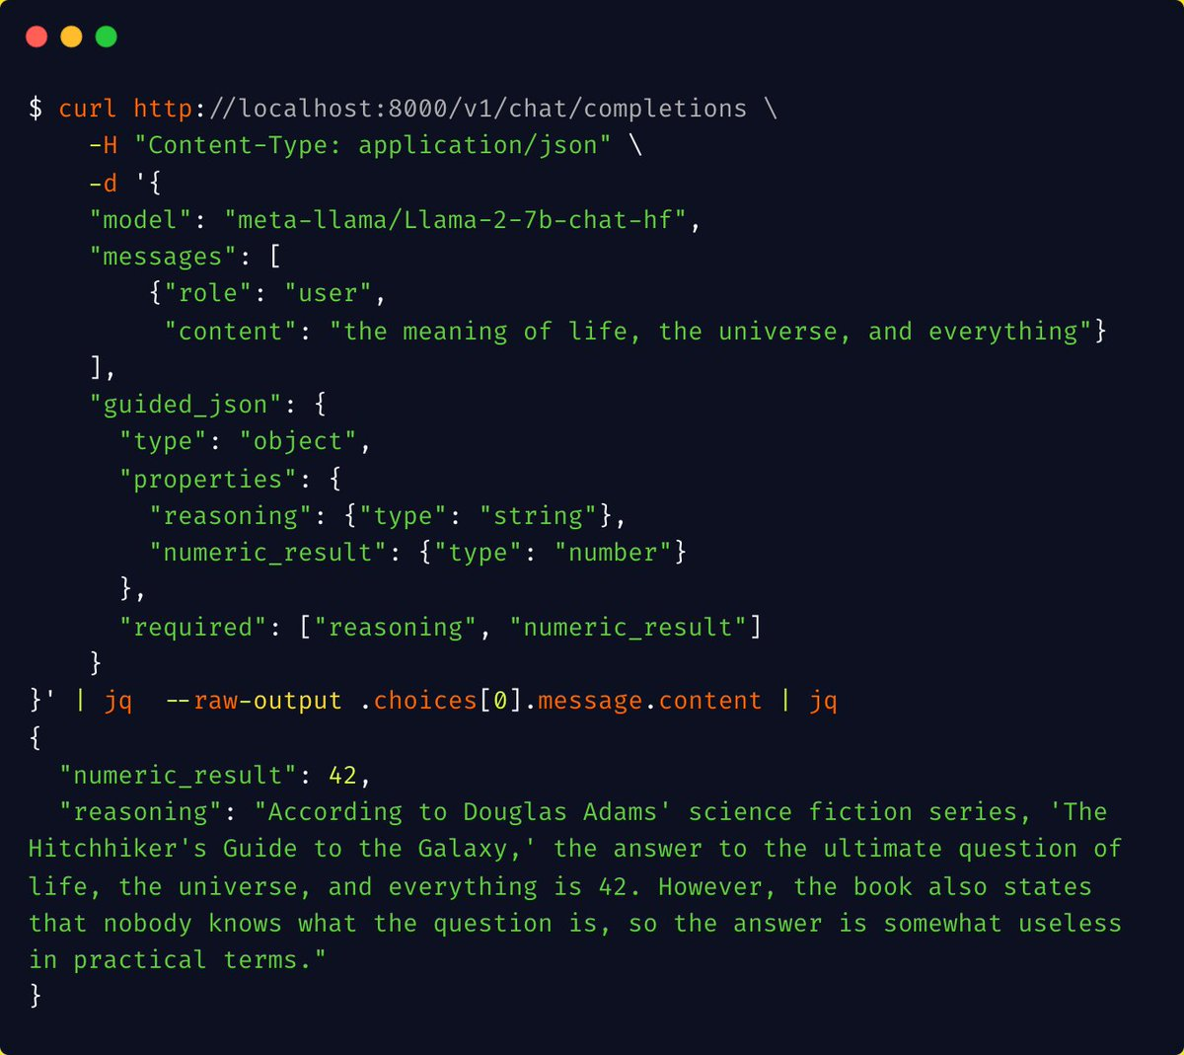
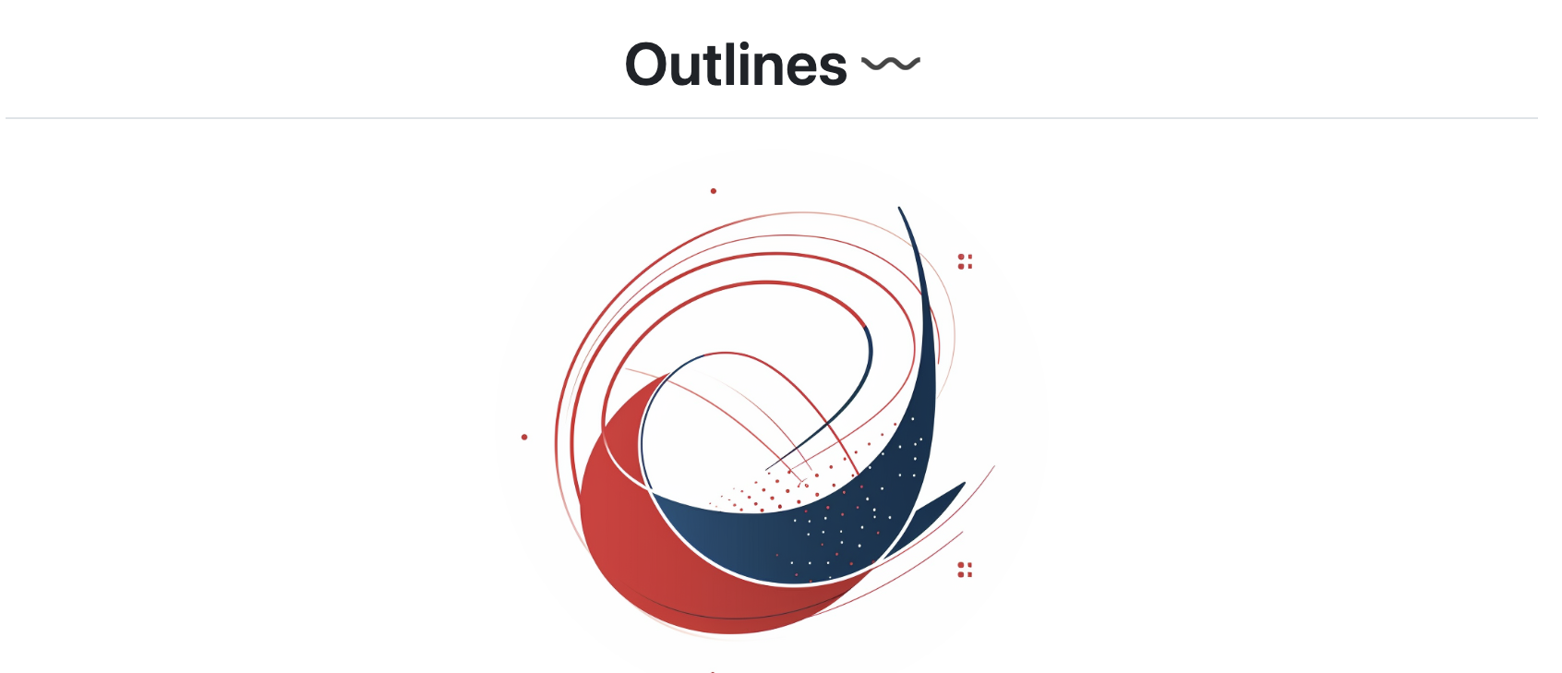
Structured Output and Tool Use
OpenAI compatibility for JSON output!
Extensible integration with Outlines, LMFE, AICI.
Recently added ability to use tool calling template
(thanks @K-Mistele!)

Slide 28
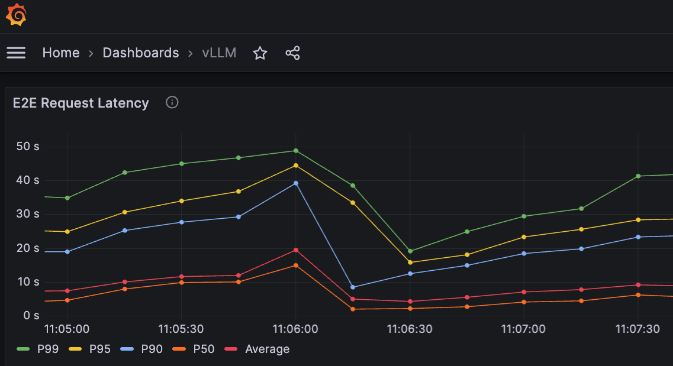
Observing vLLM through Prometheus
Monitor vLLM in real time using Prometheus/Grafana!
End-to-end metrics (e.g. request latency / throughput)
vLLM internal states (e.g. GPU memory usage, KV cache reuse rate)
and more!

Slide 29
vLLM: One-Year Journey
Model Support
Hardware Support
Model Performance
Engine Features
Distributed System Architecture
OSS Community

Slide 30
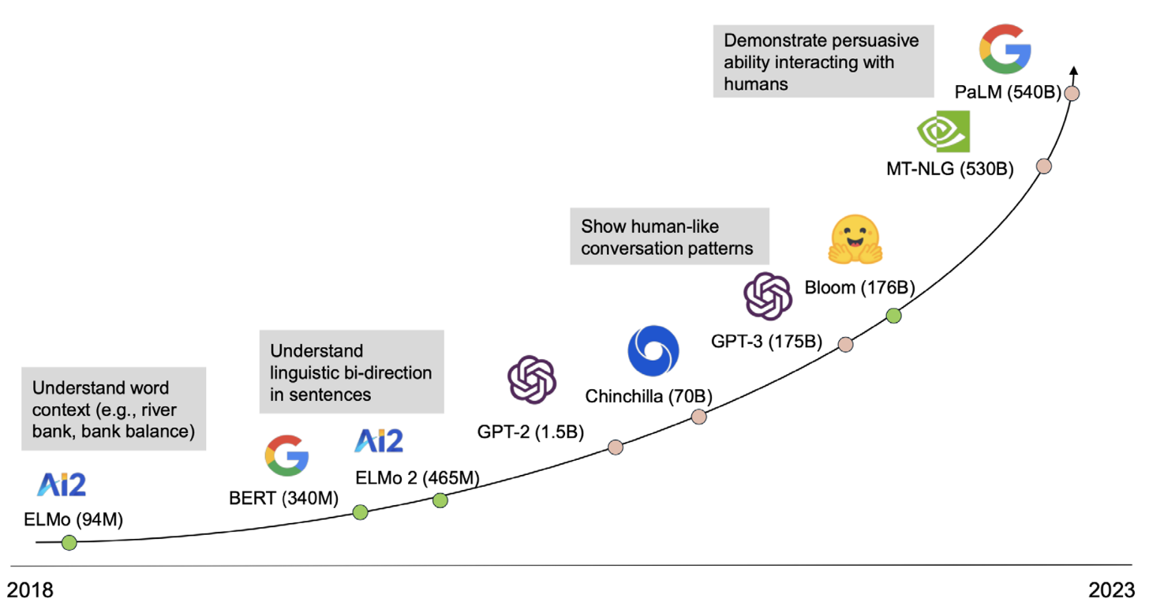
vLLM handles distributed inference for you
vLLM supports tensor parallelism from day one.
Multi-GPU/multi-node inference is a must for large LLMs
But cross-GPU/node communications are error-prone
hang/crash/versions of communication library
vLLM takes care of it for you
Debugging guide for hanging/crashing
Select best NCCL versions and set proper flags
Optimized custom allreduce for high-end machines

Slide 31
Pipeline Parallelism
Thanks to the Murali Andoorveedu (CentML) and Snowflake!
Starting v0.5.1, vLLM supports pipeline parallelism!
Best suited for larger models spanning across multiple nodes with low bandwidth connection
GPU 3
Batch 0
Batch 1
Batch 2
Batch 3
…
GPU 2
Batch 0
Batch 1
Batch 2
Batch 3
…
GPU 1
Batch 0
Batch 1
Batch 2
Batch 3
…
GPU 0
Batch 0
Batch 1
Batch 2
Batch 3
…
Time

Slide 32
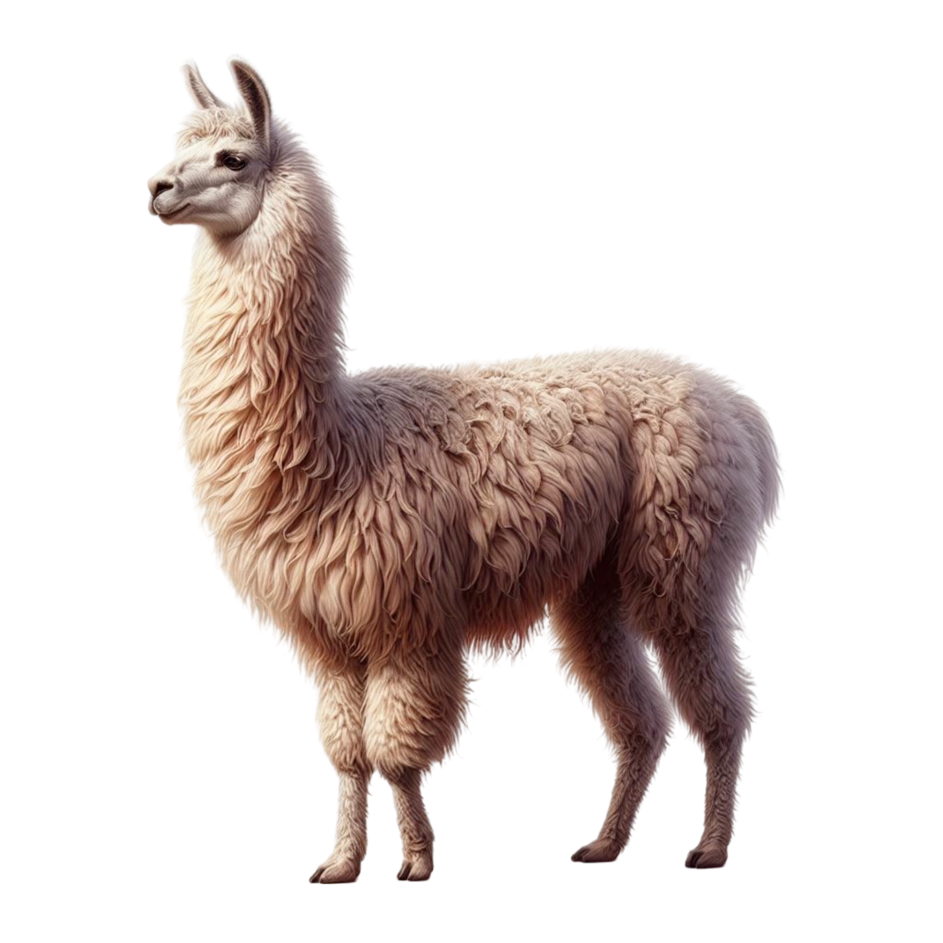
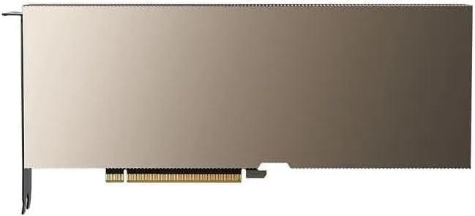
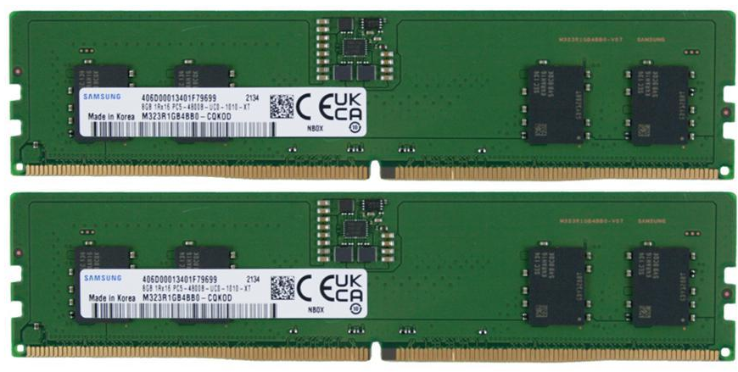
CPU Offloading
$ vllm serve meta-llama/Meta-Llama-3.1-70B -tp 4 --cpu-offload-gb 16
Llama-3-70B (140GB weights)
Turns A100-40GB into “A100-56GB” 🤩
Only offload model weights
Take care of CPU memory pressure
Side effect: slower execution time
Works best with CPU-GPU NVLink
e.g. GH 200
A100-40GB
16GB CPU memory
A100-40GB
16GB CPU memory
A100-40GB
16GB CPU memory
A100-40GB
16GB CPU memory

Slide 33
Scalable System Architecture
Tough lesson:
“To fully utilize the GPU, we need to pay close attention to everything happening on the CPU”
GPUs are fast, but CPUs are not
Minimize CPU overheads by
Multi-step scheduling
Asynchronous output processing
Efficient API server
ZMQ-Based Entrypoint
...
Details on our recent blog post (blog.vllm.ai)

Slide 34
vLLM: One-Year Journey
Model Support
Hardware Support
Model Performance
Engine Features
Distributed System Architecture
OSS Community

Slide 35
Install and develop with ease
For the latest release:
$ pip install vllm
Docker Hub: vllm/vllm-openai
Use vLLM with latest bug fixes:
Per-commit docker images and wheels
Developing on top of vLLM
$ python python_only_dev.py
No need to spent hours to compile cuda kernels!
Check out the doc for a complete guide.

Slide 36
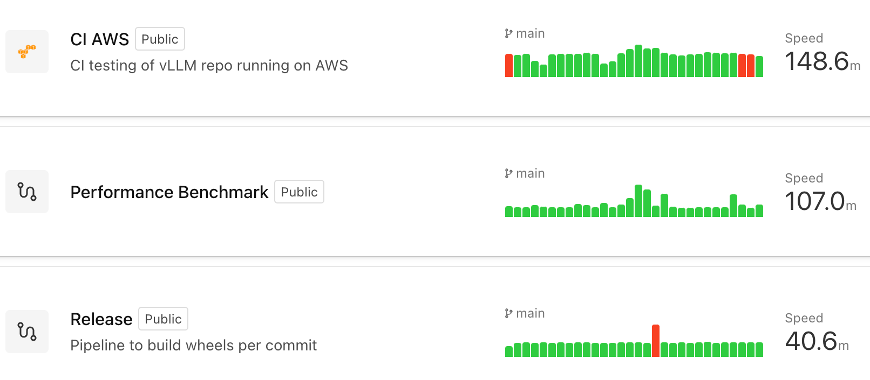
CI/CD
Thanks Kevin Luu (Anyscale) for maintenance and all the compute sponsors ($30K+/month)!
Every commit is tested with thousands of tests

Slide 37
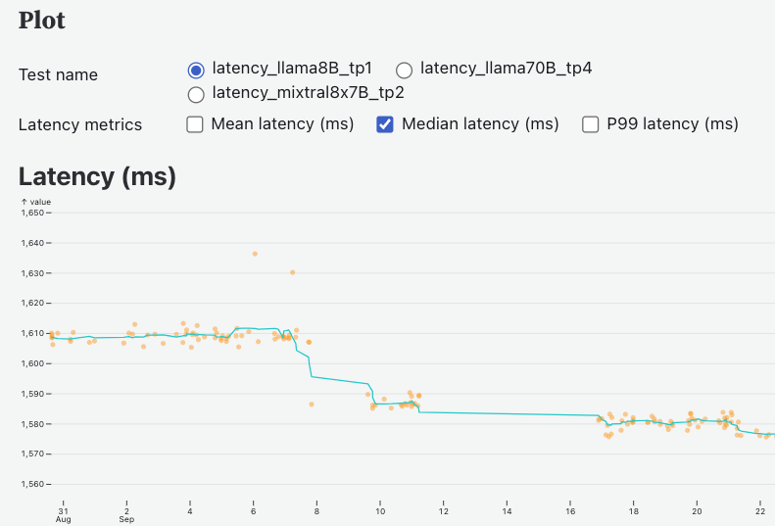
Performance Tracking
Continuous performance tracking @ https://perf.vllm.ai
Different models
Different metrics

Slide 38










Owned & Driven by Community
vLLM Meetups (every 2 months)
vLLM is joining Linux Foundation!
vLLM Office Hours (every 2 weeks)

Slide 39
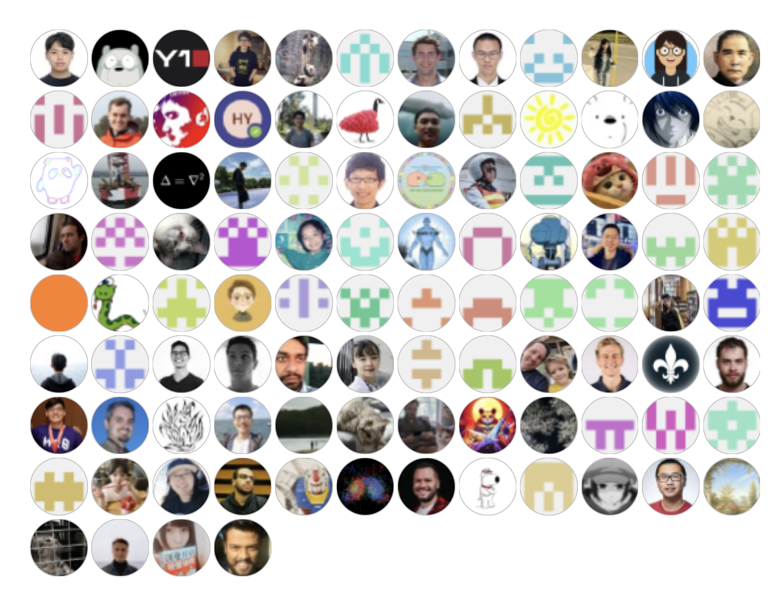
Contributors
Thanks to 560+ contributors who raised issues, participated in discussions, and submitted PRs!
…

Slide 40
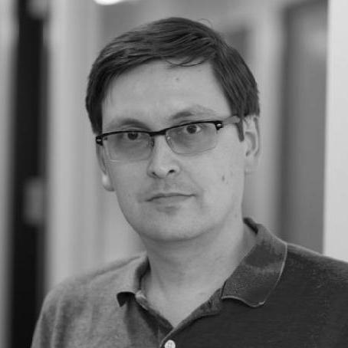



















vLLM Committers
@alexm-neuralmagic
@cadedaniel
@comaniac
@DarkLight1337
@esmeetu
@khluu
@KuntaiDu
@LiuXiaoxuanPKU
@mgoin
@njhill
@pcmortiz
@simon-mo
@rkooo567
@robertshaw2-neuralmagic
@tlrmchlsmth
@WoosukKwon
@Yard1
@ywang96
@youkaichao
@zhuohan123

Slide 41
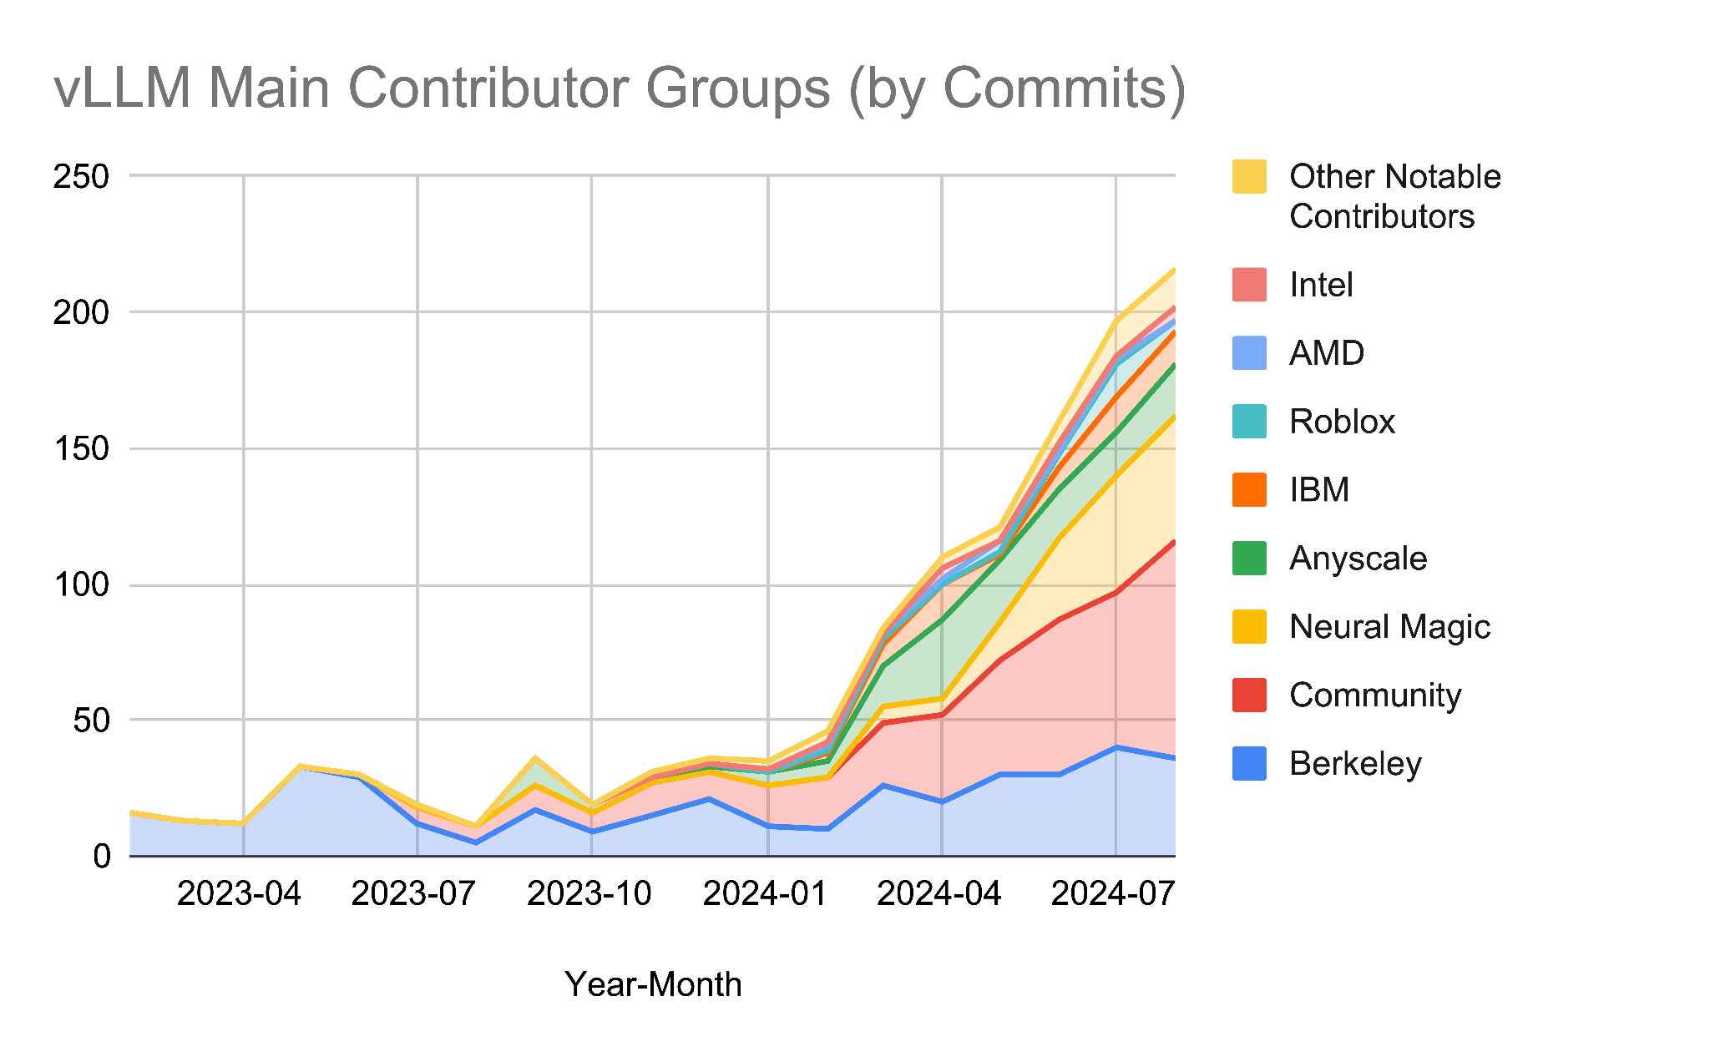
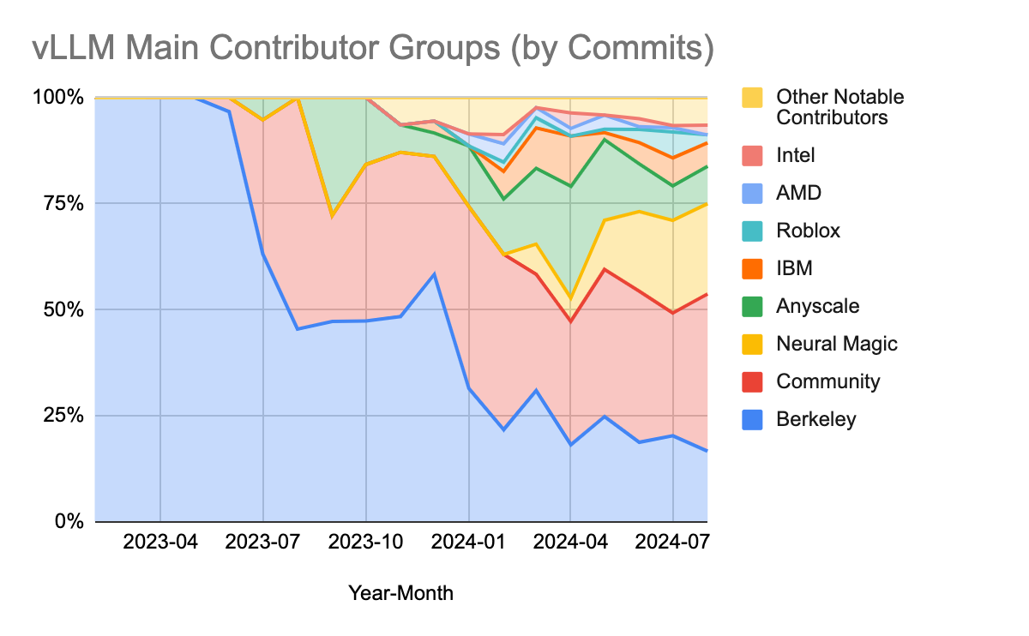
A rapidly growing true-community project!
>200 Merged PR every month
Other notable contributors: AI21, Alibaba, AWS, Bytedance, CentML, Databricks, Deepinfra, Microsoft, Mistral, NVIDIA, Oracle, Parasail, Snowflake, Tencent, …

Slide 42


















vLLM Adopters
Open-Source Projects
Companies
lm-sys/FastChat
EleutherAI/lm- evaluation-harness
allenai/open-instruct
outlines-dev/outlines
…
…

Slide 43




Productionized on Many Clouds!
SageMaker runtime for open ended generation.
Default choice powering Azure AI Studio.
Vertex Model Garden uses vLLM for Open LLMs.
Default template for serverless product!

Slide 44


















Thank you sponsors (funding compute!)

Slide 45

vLLM: The Path Forward
roadmap.vllm.ai

Slide 46
Q4 Roadmap
Suggestions welcomed!
roadmap.vllm.ai
Model Support
Enhance VLM support
Enhance SSM support
Reward model API
Hardware Support
NVIDIA H200 Perf
MI300x perf
PagedAttention on Inferentia
TPU enhancement
Upstream Intel Gaudi
Performance
Chunked prefill & prefix caching on by default
Structured output perf
Fused comm
Batched inference perf
Kernel optimization
Production Features
KV offload
KV transfer (disaggregated prefill)
Caching policy and scheduling adjustment
Spec decode optimization
Re-Architecture
vLLM engine V2: async scheduling and prefix caching centric design
torch.compile
Memory management for multi-modality
OSS Community
Perf benchmark Enhancement
Better dev doc for contribution and research

Slide 47
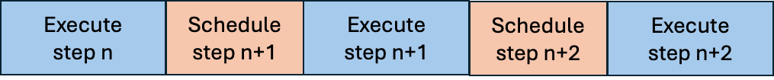
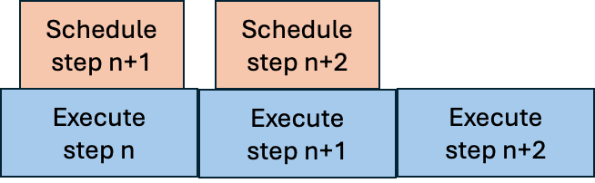
Re-arch: asynchronous scheduling
Schedule the next step while executing the current step
Less GPU idle time
GPU can immediately start executing the next step after finishing the current step
Before
After

Slide 48
Re-arch: Use prefix caching to simplify vLLM
Current vLLM
Complicated logic to handle parallel sampling / preemption
Future design
Use prefix caching to automatically identify reusable KV caches in parallel sampling/preemption scenario
Before
After
Parallel sampling
Prefix caching
scheduler
Preemption
scheduler
Parallel sampling
Prefix caching
Preemption

Slide 49
Re-arch: memory allocator for different types of KV cache
GPU memory waste due to incompatible KV cache size
E.g.: in LLama 3.2
Text: KV caches for all layers
Image: KV caches needed by only ¼ of layers, but allocated memory for all layers
Result: memory waste → lower batch size → lower performance
On-going: a new memory allocator that can handle different shapes of tensors with ease
Key idea: partition the GPU memory into pages with a large size (Level 0), then further partition each large page into different sizes to handle different KV cache sizes (Level 1).
Level 0: 6KB/page
Level 1:
Type A (2KB/page)
Type A: 2KB/page
Type B:
3KB/page
Page 0
Page 1
Page 2
Level 1:
Type B (3KB/page)
Page 3

Slide 50
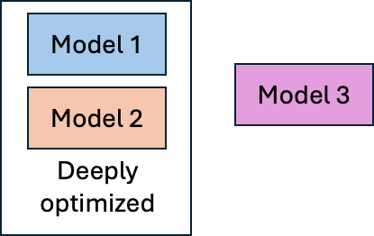
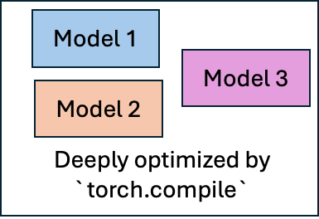
Feature: full support for torch.compile
Currently vLLM manually optimizes only the most popular models
E.g. customized cuda kernels and buffer reuse for Llama models
Ongoing: use torch.compile to optimize all models
YOUR customized models and architectures will run much faster!
Separation of optimization and model implementation, opening up new possibilities
Before
After

Slide 51
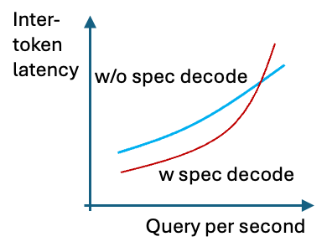
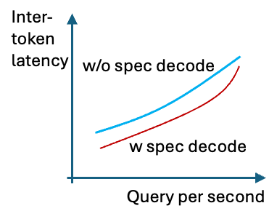
Feature: even better speculative decoding
Speculative decoding greatly accelerates LLM!
But for high QPS (query per second) case it may instead hurt performance
Coming soon
Dynamic speculative decoding that make sure speculative decoding ALWAYS make vLLM faster.
Before
After

Slide 52
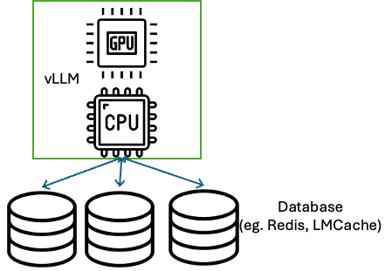

Feature: store more KV caches in CPU
vLLM only saves KV caches in GPU for future reuse
GPU memory is really limited → have to discard a lot of useful KV caches
Ongoing: offloading KV caches to CPU
Part vLLM with KV cache databases (e.g. LMCache, Redis) for even more KV cache storage!
Before
After

Slide 53
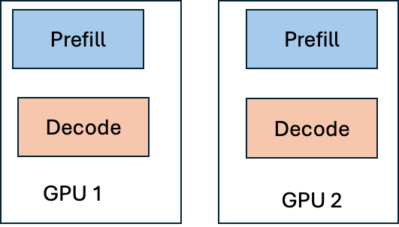
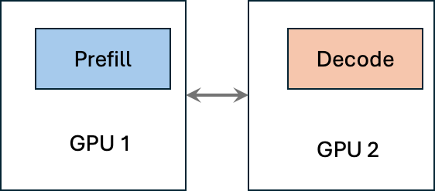
Feature: disaggregated prefilling
Disaggregated prefilling: do prefilling and decoding on different GPUs.
Why disaggregated prefilling?
Allow using different parallelization strategy for prefill & decode
Low tail inter-token latency
No need to configure hyper-parameters (but chunked prefill needs to set chunk size)
Best use when there are multiple types of GPU
Before
After

Slide 54
Our Goal
Build the fastest and
easiest-to-use open-source
LLM inference & serving engine

Slide 55






Building the fastest and easiest-to-use open-source LLM inference & serving engine!
https://github.com/vllm-project/vllm
https://discord.gg/jz7wjKhh6g
https://vllm.ai
https://twitter.com/vllm_project
https://arxiv.org/abs/2309.06180
https://opencollective.com/vllm

